Slide 1

HIRING PROCESS ANALYTICS
By Anjali Sahni

Slide 2

PROJECT DESCRIPTION
The project, Hiring process analysis, was developed to perform an in-depth analysis of a company's hiring process, focusing on key aspects such as gender representation, salary trends, departmental structure, and job hierarchy.
By analyzing these factors, the project aimed to provide valuable insights into hiring patterns and organizational dynamics.

Slide 3
APPROACH & TECH-STACK USED
For this project, Microsoft Excel 2022 was selected as the primary tool for data analysis due to its versatility and robust capabilities in handling tabular data.
Specific techniques such as pivot tables, charts, and formulas were employed to analyze the data.
I have used canva for making this presentation
as it contains required Elements, Graphs,
Images which made this project more
attractive.

Slide 4
INSIGHTS AND RESULT
Analysis of gender distribution provided insight.
Salary analysis revealed.
Examination of departmental composition highlighted.
Analysis of position tiers uncovered.
Meaningful trends and patterns were observed in the data, shedding light on.

Slide 5
DRIVE LINK
The final report has been saved as a PDF file and uploaded to Google Drive.
You can access the report through the following link: Click to open Excel Sheet

Slide 6
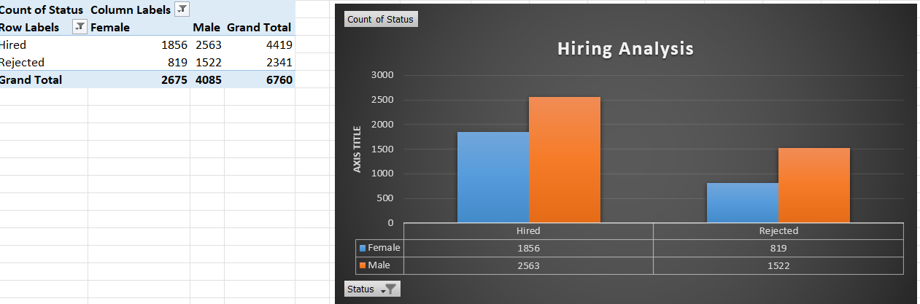
HIRING ANALYSIS
Determine the gender distribution of hires. How many males and females have been hired by the company?

Slide 7
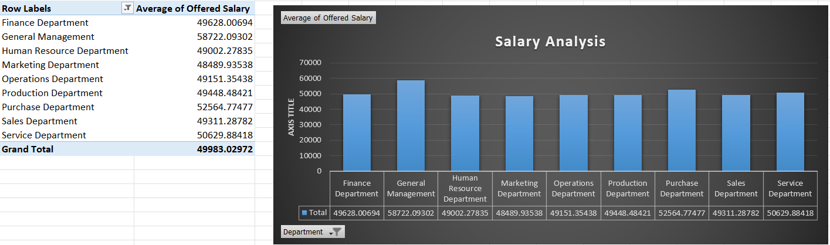
SALARY ANALYSIS
What is the average salary offered by this company? Use Excel functions to calculate this.

Slide 8
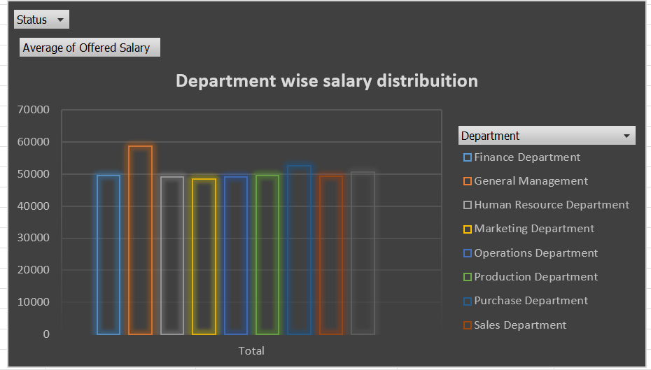
SALARY DISTRIBUTION
Create class intervals for the salaries in the company. This will help you understand the salary distribution.

Slide 9
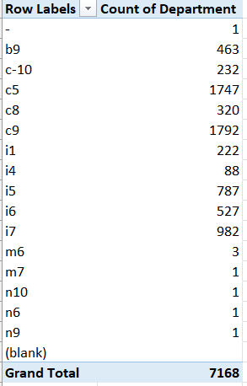
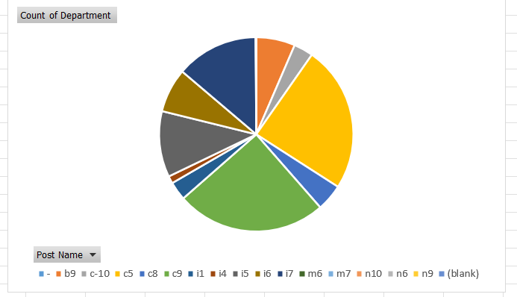
DEPARTMENTAL & POSITION TIER ANALYSIS
Use a pie chart, bar graph, or any other suitable visualization to show the proportion of people working in different departments and different position tiers within the company.

Slide 10
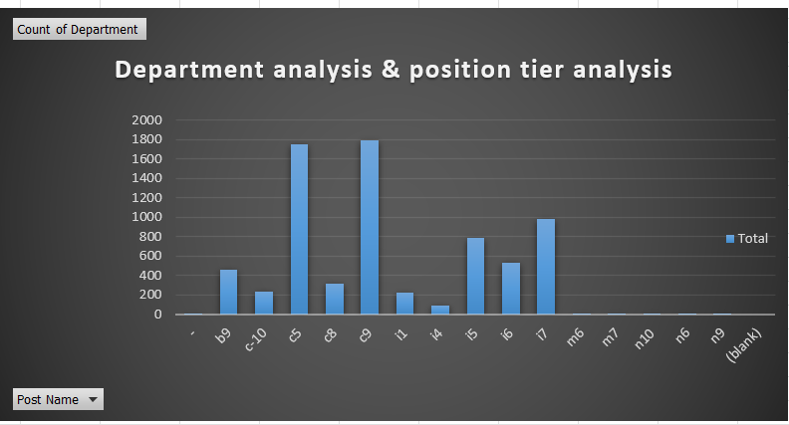
DEPARTMENTAL & POSITION TIER ANALYSIS
Use a pie chart, bar graph, or any other suitable visualization to show the proportion of people working in different departments and different position tiers within the company.

Slide 11
THANK YOU

